Slide 1

TEAM MENDIT A walkthrough
We present the work done in the last 2 weeks here in this presentation.

Slide 2


1.) Logo designing
We designed 2 logos and had a survey and social media responses along with the team deliberations to select one amongst them.

Slide 3
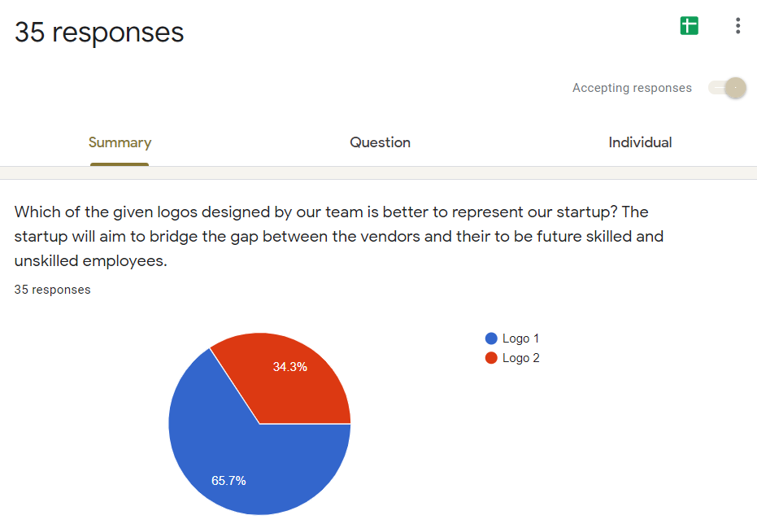
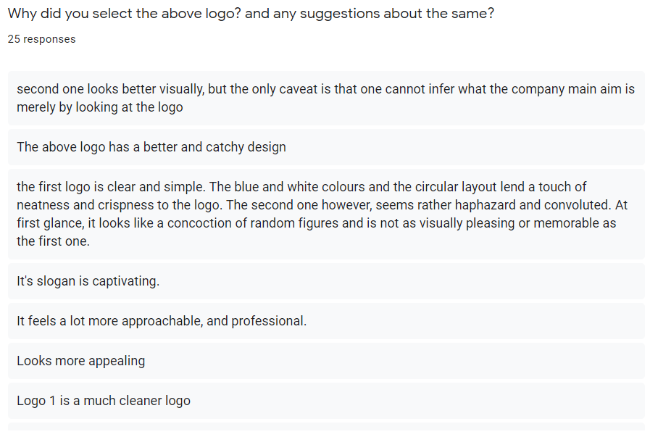
2.) Logo feedback survey conducted.
We conducted a google forms, WhatsApp and Facebook surveys and below are the responses and their analysis.

Slide 4
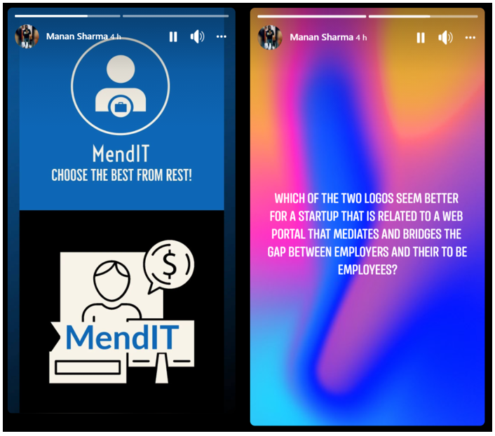
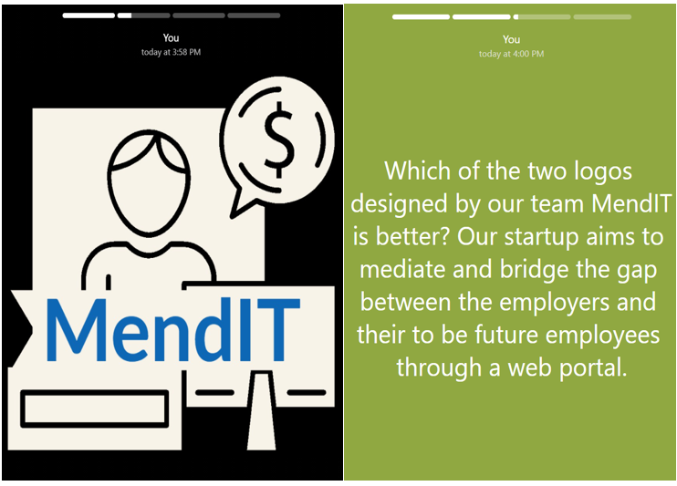

Slide 5
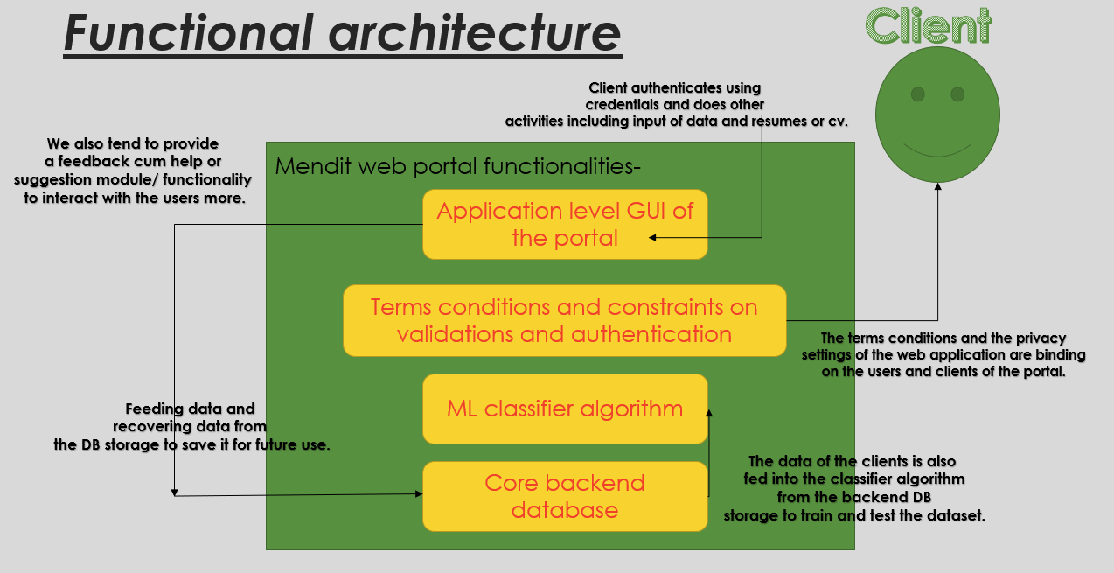
3.) Architecture design.
The following is the architectural diagram that is a data flow diagram level one designed by our team for our software in development.

Slide 6
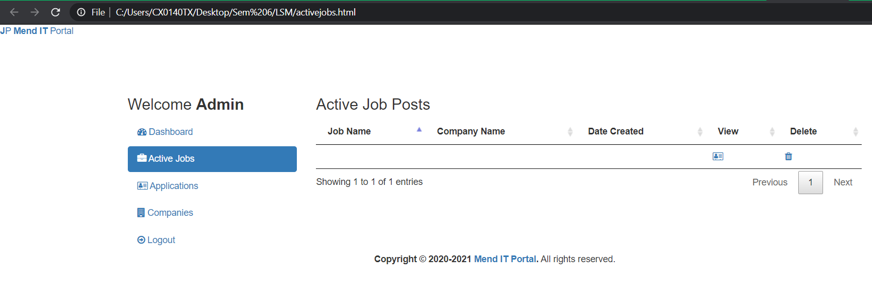
4.) GUI frontend designing.
We are done with the frontend GUI design of 5 of our webpages that link together and have tried to keep them as professional as possible following the HCI principles and the principles of software engineering.

Slide 7
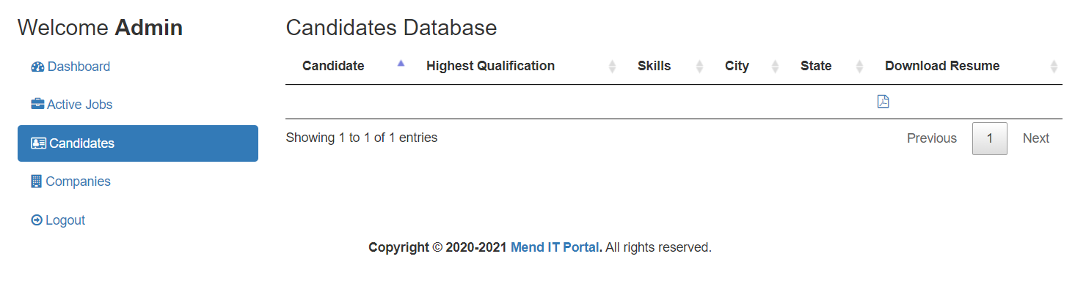
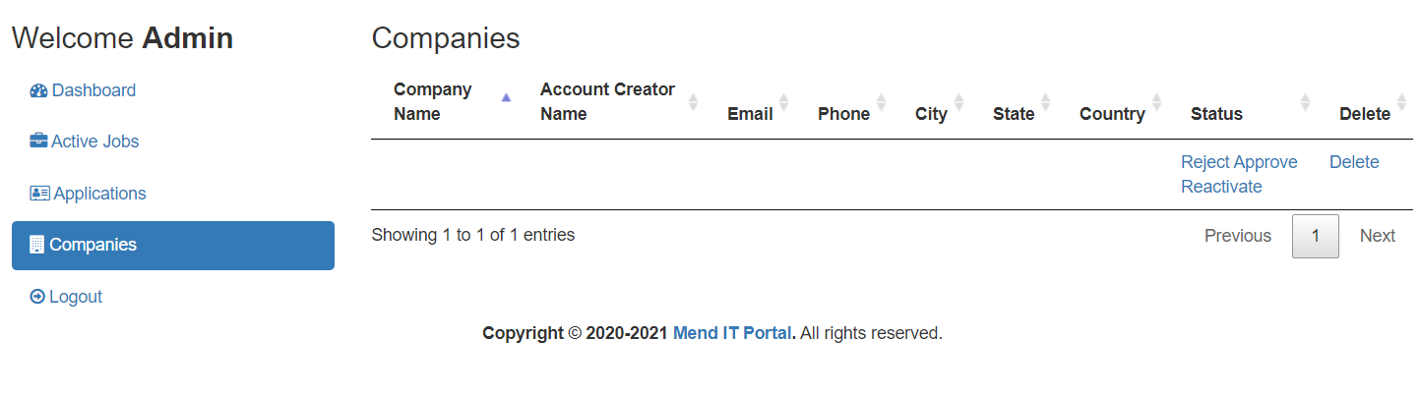

Slide 8
5.) ML algorithm
We have finally decide to incorporate the ML algorithm and the purpose that it will serve. It will act as one of the USP of our project software.
We will be using it to give a recommendations to the vendors about the employees on the basis of the resumes of the employees as well as the job role requirements of the vendors or the employers. This will be the use of the ML SVM classifier algorithm in our portal.

